Slide 1

Enterprise Resource Planning
Stratos
Taking Business to new heights…

Slide 2









Project Over View
Project Details
Client Information
Project Business Need
Project Architecture
Project Module Explanation
Functional Dependencies
Business Workflow
Effort & Estimation

Slide 3





Project Details
Domain : Enterprise Resource Planning
Client : Pixel Storm Interactive
Location : United States of America
Project Timeline : 26 Months
Frame Work : Agile Framework

Slide 4
Pixel Storm interactive
Pixel Storm Interactive is a mid-sized American game development studio known for building immersive story-driven RPGs and high-energy multiplayer experiences.
As Pixel Storm scaled operations, They faced challenges like:
Fragmented workflows across teams and time zones
Manual finance and HR slowing down execution
Difficulty managing cross-platform revenues and IP assets
Outsourced content and vendor chaos

Slide 5







Business Need
Centralized Data
Operational Efficiency
Real Time Reporting and Analytics
Cost Reduction
Better Inventory and Supply Chain Management
Enhanced Customer Service

Slide 6
Project Architecture
Super Admin
Home page
Home
Members
Third Parties
Products / Servies
MRP
Projects
Billing & Payment
HRM
Agenda
Tools

Slide 7
Project Module Explanation

Slide 8
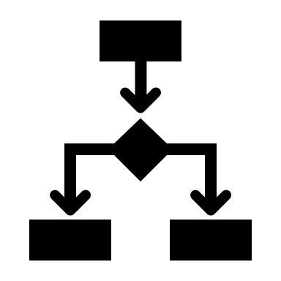
Functional Dependencies

Slide 9

Business Workflow

Slide 10

Effort Estimation

Slide 11
Thank you…

